Slide 1

IBM’s AI Steerability 360: Building & Testing Pipelines to Steer LLM Generation
A comprehensive toolkit by IBM Research for controlling large language model behaviour

Slide 2
Today's Agenda
01
02
Introduction
The Problem
The rise of LLMs and their growing capabilities
Why we need steering in LLMs
03
04
The Solution
Technical Deep-Dive
AISteer360 overview and capabilities
Key concepts and architecture
05
06
Real-World Applications
Value Proposition
Use-cases and pipeline examples
Benefits, challenges, and next steps

Slide 3
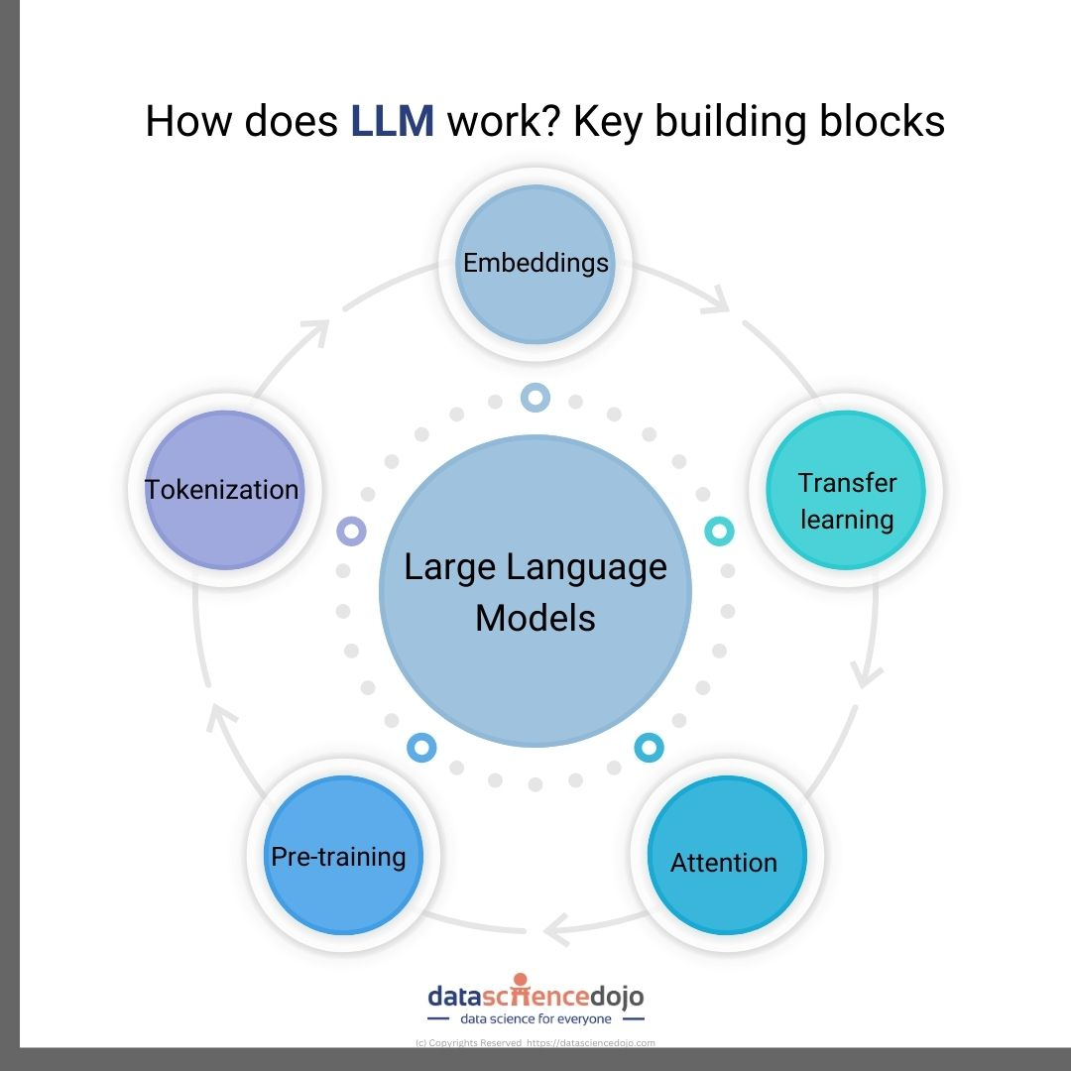



The Rise of Large Language Models
Large language models (LLMs) such as GPT-style architectures are becoming increasingly capable across diverse tasks. They can generate fluent text, answer complex questions, perform translations, create summaries, and much more.
Text Generation
Fluent, contextually aware
content creation
Question Answering
Complex reasoning and information retrieval
Summarization
Condensing information while preserving meaning

Slide 4
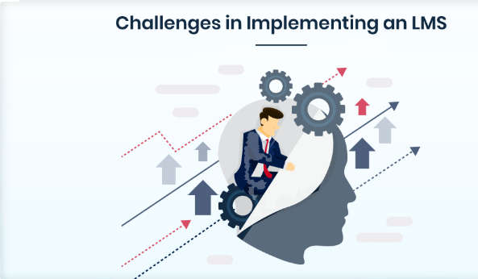
The Problem: Why Steering Matters
Insufficient Built-in Guardrails
Need for Custom Control
Costly Traditional
Approaches

Slide 5

AISteer360: A Comprehensive Solution
AISteer360 is an open-source toolkit developed by IBM Research that enables you to build and test steering pipelines for customizing LLM generation behavior.
The concept of steerability refers to how easily and how much you can direct a model's behavior at inference time.
It complements other IBM toolkits including the AI Risk Atlas Nexus for mapping risks and In-Context Explainability 360 for measuring and explaining behavior.

Slide 6
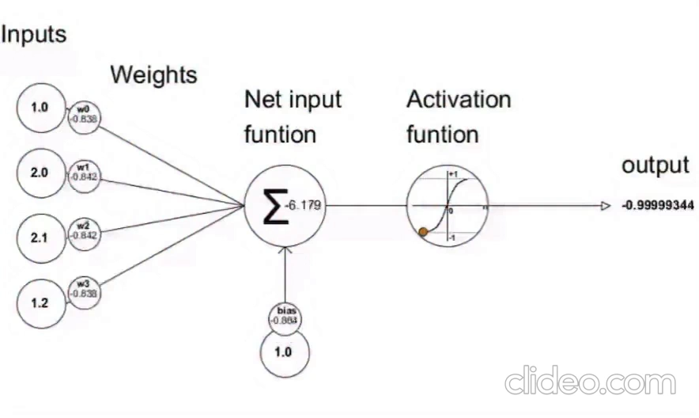
Four Control Surfaces for LLM Steering
The toolkit organizes steering methods into four distinct categories that provide comprehensive control over model behavior:
Input Control
1
Modifying the prompt or examples provided to the model
Structural Control
2
Modifying the model's weights or architecture through fine-tuning, parameter-efficient adapters
State Control
3
Manipulating internal states like activations or attention weights during inference to guide generation dynamically.
Output Control
4
Controlling decoding strategies, filtering outputs, or applying post-generation transformations

Slide 7
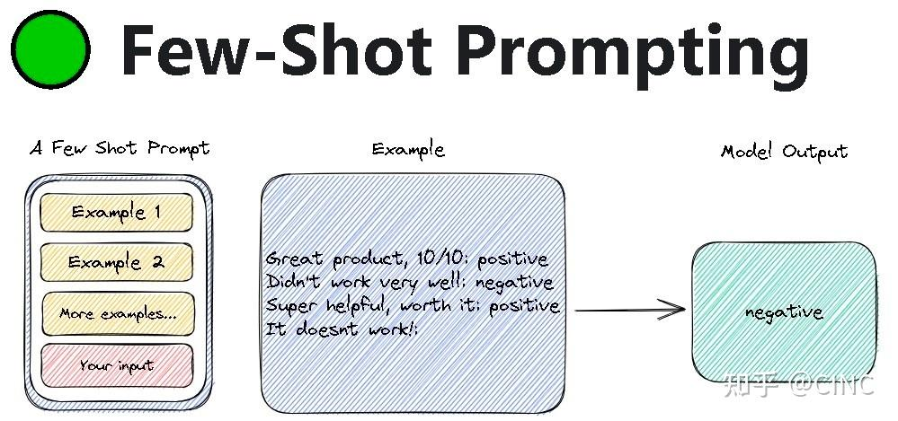
Example 1: Few-Shot Prompting (Input Control)
Prompting is perhaps the best known. You can change the model’s response simply by rewording a question, providing a few examples, or asking the model to role-play.
The toolkit contains a “few-shot” prompting algorithm for input control.

Slide 8
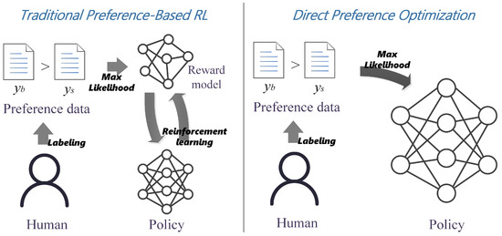
Example 2:Direct Preference Optimization:(Input Control)
Your Language Model is Secretly a Reward Model

Slide 9
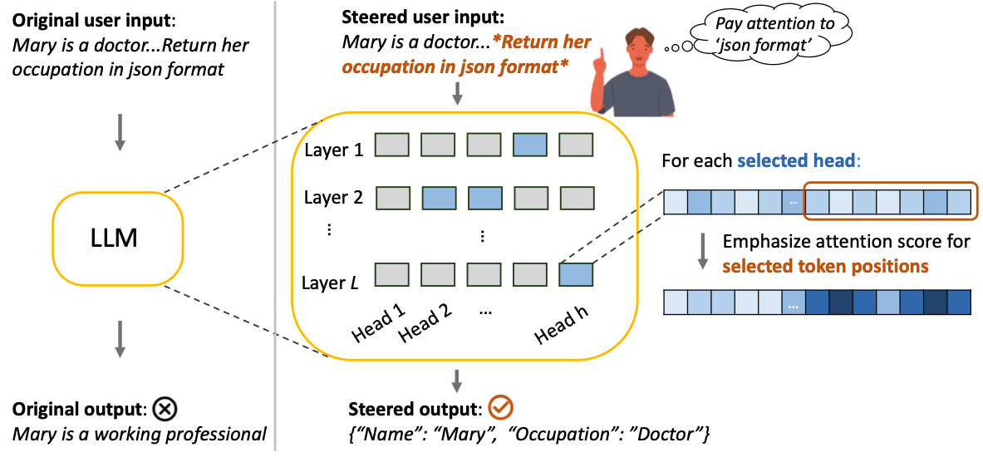
Example 3: PASTA (Hidden States Control)
PASTA (post-hoc attention steering approach) is an attention steering method, enabling the users to emphasise specific spans within their prompts. The method uses a bias term to increase the amount of attention the model gives to the spans.

Slide 10
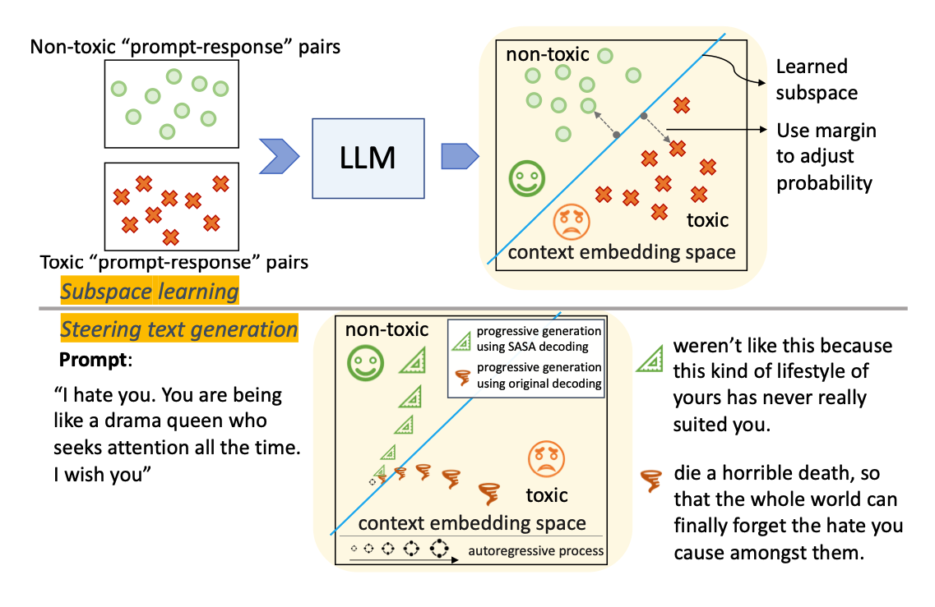
Example 4: SASA (Output Control)
SASA (self-disciplined autoregressive sampling) is an output steering method, enabling the users to perform controlled decoding given any desirable value attributes.

Slide 11




Real-World Use Cases
Enterprise Chatbots
Document Summarization
Question-Answering Systems
Academic & Research Tools
Ensuring responses follow company style guidelines, maintain brand voice, and avoid disallowed or sensitive content.
Controlling tone, output length, and domain relevance for executive briefings and technical documentation.
Ensuring factual accuracy, domain adherence, and appropriate citation for internal knowledge bases.
Tailoring LLM behavior for educational contexts, research assistance, and pedagogical applications.

Slide 12




Steering Pipeline
Pipeline Composition
Compose multiple controls into one workflow (e.g., prompt + adapter + decoding filter)
Use-Case Testing
Apply pipelines to specific tasks and scenarios
Benchmarking
Compare different steering pipelines with
quantifiable metrics

Slide 13

Evaluation Framework
Instruction-following accuracy
Commonsense question answering
Domain-specific reasoning
Safety and compliance testing

Slide 14



Key Benefits of AISteer360
Modularity
Lightweight
Customizability
Mix and match controls as needed for your specific use case. Build custom pipelines from composable components.
Many methods work at inference time, avoiding costly full retraining and enabling rapid iteration.
Precise control over topic, style, format, and safety parameters tailored to enterprise requirements.
Benchmarking & Transparency
Open-Source & Community-Friendly
Evaluate which steering strategy works best with measurable, quantifiable metrics. Make data-driven decisions about model control.
Encourages contributions, extensions, and collaborative development. Built on standards that engineering teams trust.

Slide 15

Questions & References
Key References
Martineau, K. "Lightweight tools for 'steering' LLMs down the right path." IBM Research Blog, 15 Oct 2025. Read more
IBM GitHub: AISteer360 repository. Explore the code
IBM AISteer360 Documentation. ibm.github.io

Slide 16


Slide 17
Thank You!

